Slide 1
Qualifying Exam:
A review on the recent advances in subset selection problems in Large Language Models
Souradeep Nanda (SXN230039)

Slide 2
Contents
In Context Learning (ICL)
Retrieval Augmented Generation (RAG)
Subset Selection in LLMs with RAG and ICL

Slide 3
What is In-Context Learning for LLMs?
Context: Jack has an apple. Jill has a ball.
Question: What does Jack have?
Answer: apple

Slide 4
Larger Models Scale Better for ICL (1 / 2)
Zero Shot
English: I would like to visit Paris next summer. French: Je voudrais rendre l'avenir de Paris.
I would like to give back the future of Paris.
One Shot
English: We plan to visit Rome next month. French: Nous prévoyons de visiter Rome le mois prochain. English: I would like to visit Paris next summer. French: Je voudrais rendre à Paris le mois prochain.
I would like to go to Paris next month.
Two Shot
English: We plan to visit Rome next month. French: Nous prévoyons de visiter Rome le mois prochain. English: Paris is beautiful in the summer. French: Paris est magnifique en été. English: I would like to visit Paris next summer. French: Je voudrais visiter Paris en été.
I would like to visit Paris in summer.
Chung et al (2024) Scaling Instruction-Finetuned Language Models (https://arxiv.org/pdf/2210.11416)

Slide 5
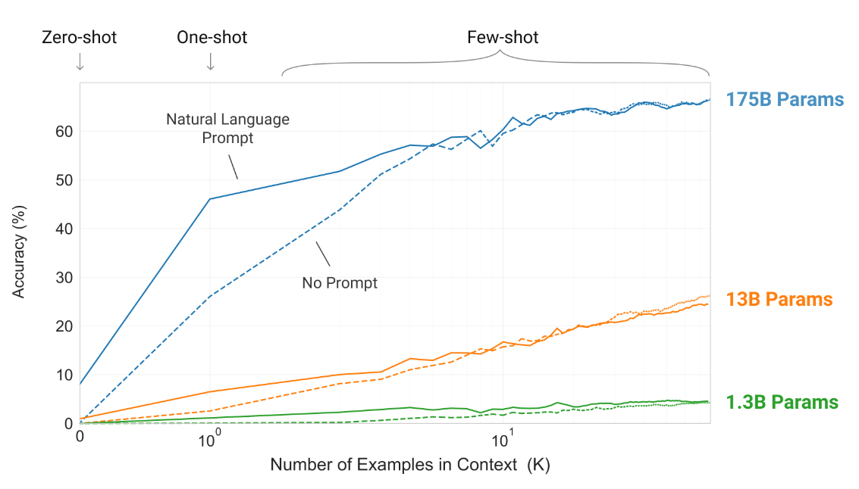
Larger Models Scale Better for ICL (2 / 2)
Brown et al. (2020) Language Models are Few-Shot Learners (https://arxiv.org/pdf/2005.14165)

Slide 6
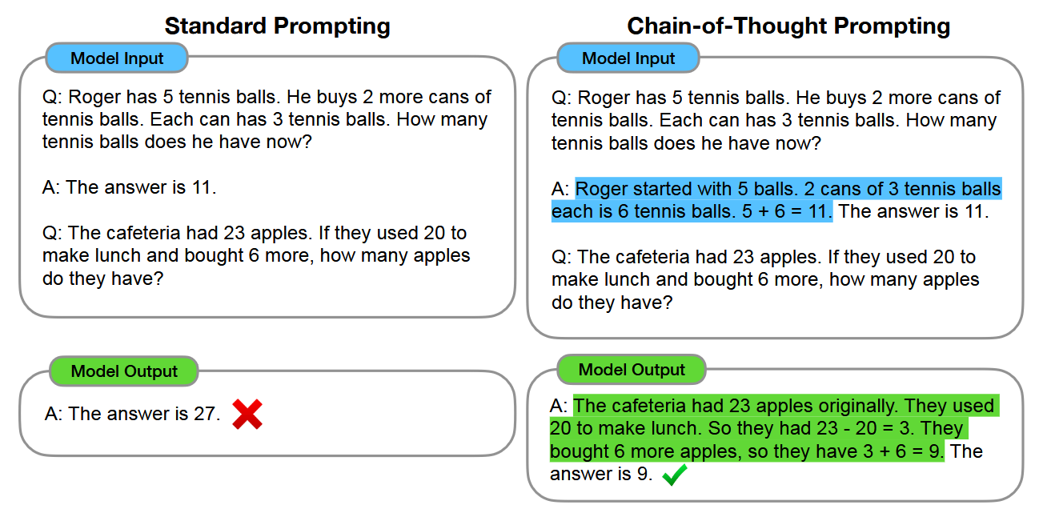
Chain of thought ( 1 / 3)
Wei et al. (2022b) Chain of Thought Prompting Elicits Reasoning in Large Language Models (https://arxiv.org/pdf/2201.11903)

Slide 7
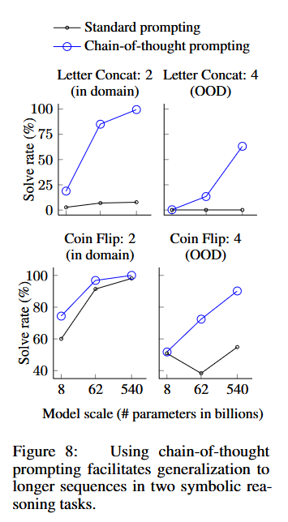
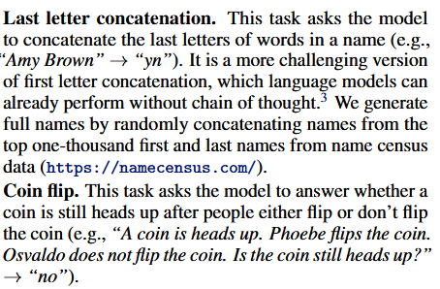
CoT: Scaling ( 2 / 3)
Wei et al. (2022b) Chain of Thought Prompting Elicits Reasoning in Large Language Models (https://arxiv.org/pdf/2201.11903)

Slide 8
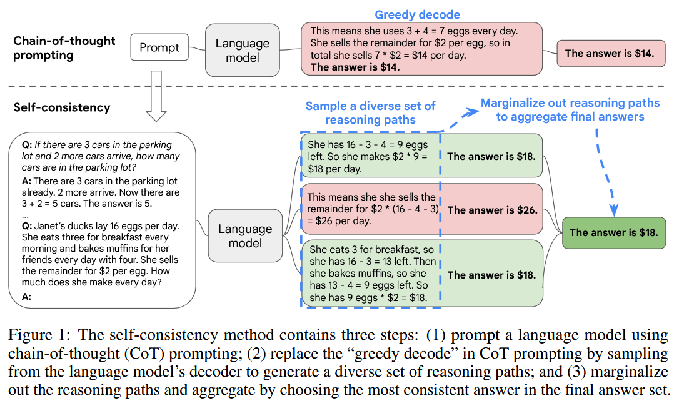
CoT: Self consistency ( 3 / 3)
Wang et al. (2022a) Self-Consistency Improves Chain of Thought Reasoning in Language Models (https://arxiv.org/pdf/2203.11171)

Slide 9
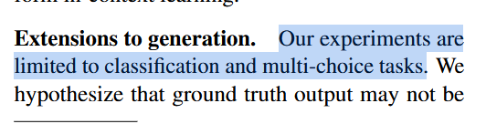
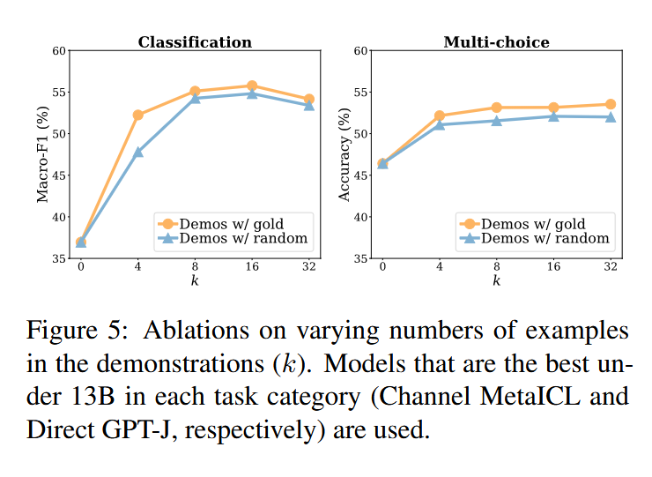
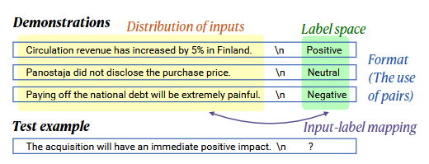
Why does ICL work?
Min et al. (2022) Rethinking the Role of Demonstrations: What Makes In-Context Learning Work (https://arxiv.org/pdf/2202.12837)

Slide 10
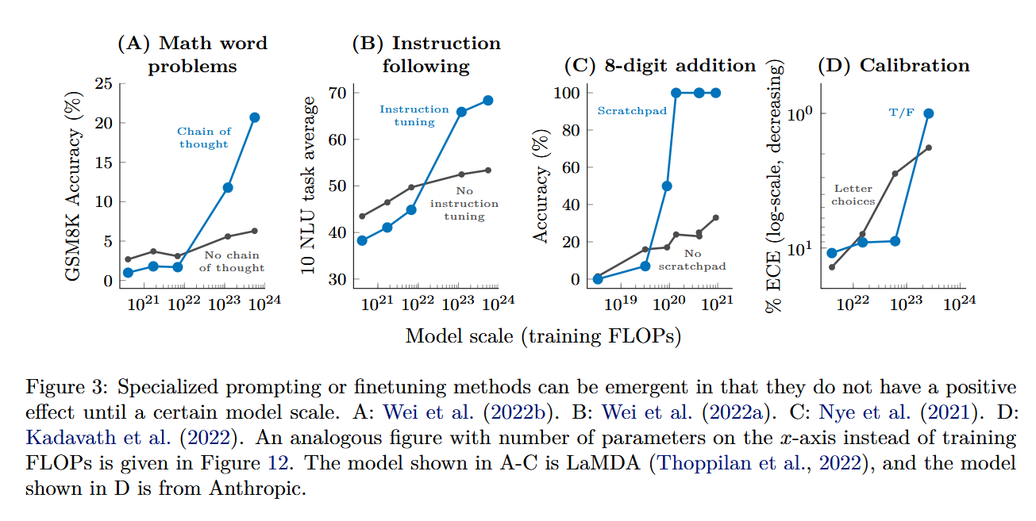
Certain Compute Scale is Required
Wei et al. (2022a) Emergent Abilities of Large Language Models (https://arxiv.org/pdf/2206.07682)

Slide 11
Contents
In Context Learning (ICL)
Retrieval Augmented Generation (RAG)
Subset Selection in LLMs with RAG and ICL

Slide 12
Core Idea of RAG
Question: What does Jack have?
Information Retrieval
Documents (Non-Parametric)
Jack has an Apple
Jill has a Ball
Bob has a Banana
Model Knowledge (Parametric)
Context: Jack has an Apple
Question: What does Jack have?
Answer: Apple
Data Incorporation

Slide 13
Core Idea of RAG
Question: What does Jack have?
Information Retrieval
Documents (Non-Parametric)
Jack has an Apple
Jill has a Ball
Bob has a Banana
Model Knowledge (Parametric)
Context: Jack has an Apple
Question: What does Jack have?
Answer: Apple
Data Incorporation

Slide 14
Information Retrieval Strategy: Maximum Inner Product (1 / 3)
Jill has a Ball
[0.34, 0.24, …, 0.27]
Jack has an Apple
LLM
Embedding
[0.23, 0.33, …, 0.52]
What does Jack have?
[0.54, 0.44, …, 0.26]
What does Jill have?
[0.64, 0.64, …, 0.42]
Lewis et al. (2020) Retrieval-Augmented Generation for Knowledge-Intensive NLP Tasks (https://arxiv.org/pdf/2005.11401)

Slide 15
Information Retrieval Strategy: Maximum Inner Product (2 / 3)
Jack has an Apple
Jill has a Ball
What does Jack have?
0.9
0.4
What does Jill have?
0.3
0.6
Lewis et al. (2020) Retrieval-Augmented Generation for Knowledge-Intensive NLP Tasks (https://arxiv.org/pdf/2005.11401)

Slide 16
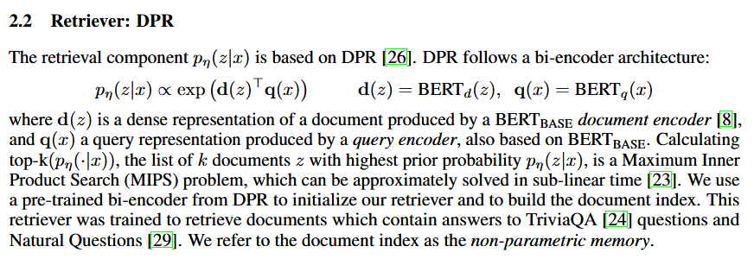
Information Retrieval Strategy: Maximum Inner Product (3 / 3)
Document = z
Query = x
Lewis et al. (2020) Retrieval-Augmented Generation for Knowledge-Intensive NLP Tasks (https://arxiv.org/pdf/2005.11401)

Slide 17
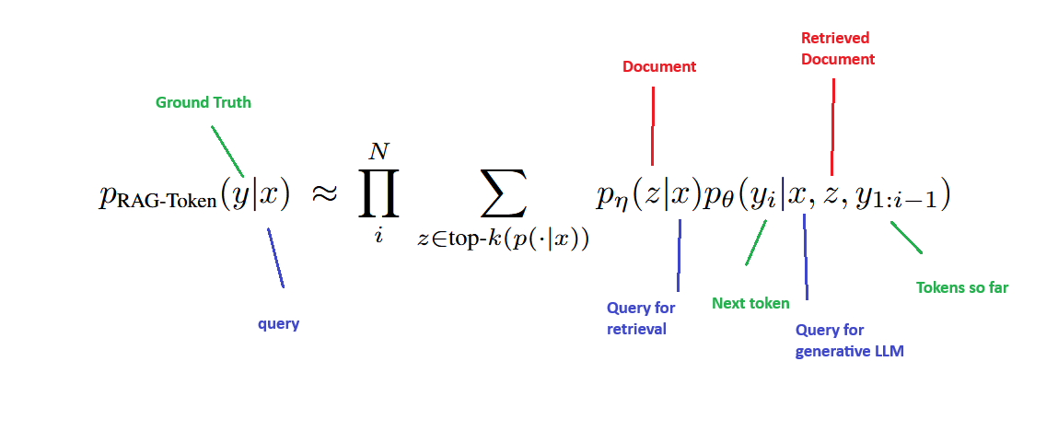
End-To-End Training Lewis et al. (2020)
Lewis et al. (2020) Retrieval-Augmented Generation for Knowledge-Intensive NLP Tasks (https://arxiv.org/pdf/2005.11401)

Slide 18
Questions Are All You Need to Train a Dense Passage Retriever ( 1 / 4)
Jack has an Apple
What does Jack have?
0.6
What does Jill have?
0.3
Sachan et al. (2022) Questions Are All You Need to Train a Dense Passage Retriever (https://arxiv.org/pdf/2206.10658)

Slide 19
Questions Are All You Need to Train a Dense Passage Retriever ( 2 / 4)
LLM
Jack has an Apple
What fruit does Jack have?
What does Jack have?
0.6
0.9
What does Jill have?
0.3
0.4
Sachan et al. (2022) Questions Are All You Need to Train a Dense Passage Retriever (https://arxiv.org/pdf/2206.10658)

Slide 20
Questions Are All You Need to Train a Dense Passage Retriever ( 3 / 4)
LLM
Jack has an Apple
What fruit does Jack have?
What does Jack have?
0.6
0.9
What does Jill have?
0.3
0.4
But running this LLM is expensive, so we distill the knowledge back to the retriever
Sachan et al. (2022) Questions Are All You Need to Train a Dense Passage Retriever (https://arxiv.org/pdf/2206.10658)

Slide 21
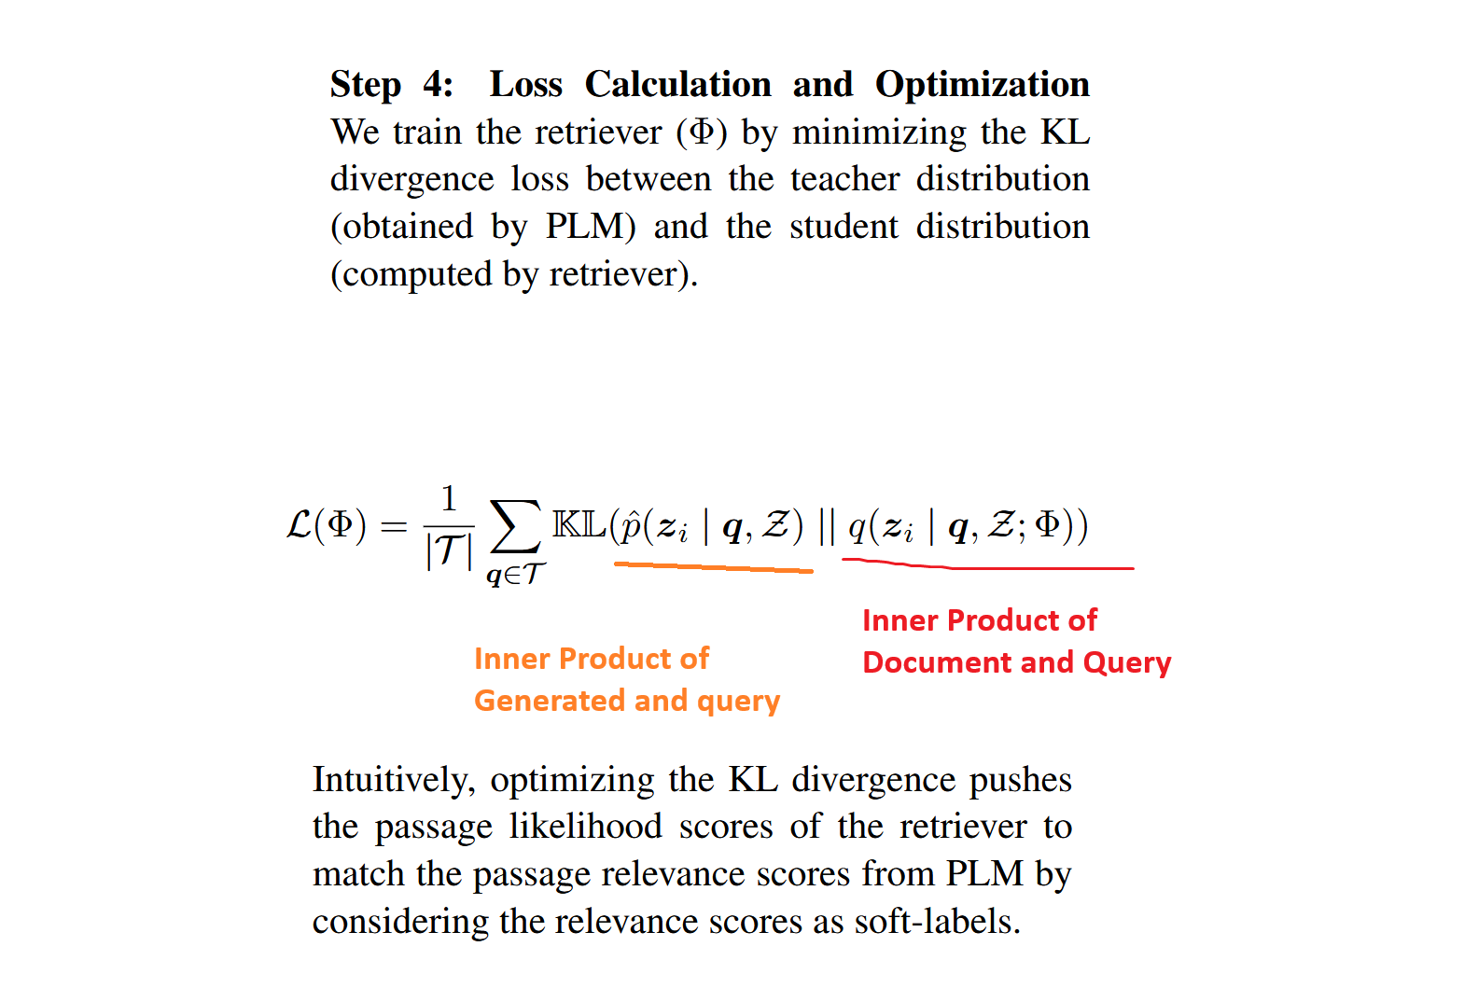
Questions Are All You Need to Train a Dense Passage Retriever ( 4 / 4)
Sachan et al. (2022) Questions Are All You Need to Train a Dense Passage Retriever (https://arxiv.org/pdf/2206.10658)

Slide 22
Efficient Training of Retrieval Models Using Negative Cache (1 / 3)
This is paper from Google
Motivation: Can we keep updating the non-parametric index while training?
Useful for Google Search results as the underlying websites update as well.
Lindgren et al. (2021) Efficient Training of Retrieval Models Using Negative Cache (https://patents.google.com/patent/US20230153700A1/en)

Slide 23
Efficient Training of Retrieval Models Using Negative Cache (2 / 3)
Training flow
We have a query network and a document network
Take query embedding and positive document embedding
Retain the data and embeddings from previous iterations
Search cache with perturbed maximum inner product search. This is the negative document.
Get the fetched document from cache and feed it into the document network so that we can backprop with current weights
Apply loss on query embedding, positive document embedding and negative document embedding.
Randomly sample a few documents, compute their embedding and push onto the cache, removing the oldest entries.
Lindgren et al. (2021) Efficient Training of Retrieval Models Using Negative Cache (https://patents.google.com/patent/US20230153700A1/en)

Slide 24
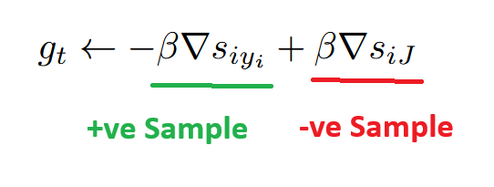
Efficient Training of Retrieval Models Using Negative Cache (3 / 3)
Core Idea:
Entries in the dense index for MIPS generated with a previous checkpoint is analogous to just noising the current query
Training flow
We have a query network and a document network
Take query embedding and positive document embedding
Retain the data and embeddings from previous iterations
Search cache with perturbed maximum inner product search. This is the negative document.
Get the fetched document from cache and feed it into the document network so that we can backprop with current weights
Apply loss on query embedding, positive document embedding and negative document embedding.
Randomly sample a few documents, compute their embedding and push onto the cache, removing the oldest entries.
Lindgren et al. (2021) Efficient Training of Retrieval Models Using Negative Cache (https://patents.google.com/patent/US20230153700A1/en)

Slide 25
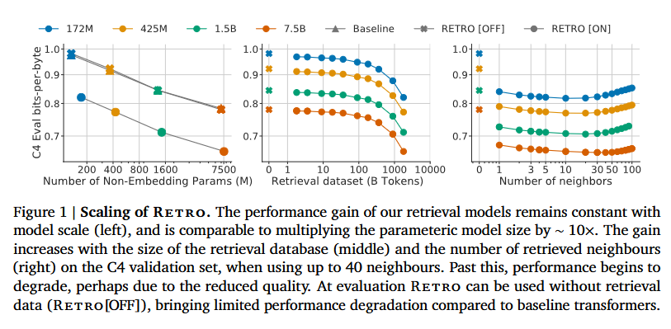
Improving language models by retrieving from trillions of tokens
Borgeaud et al. (2021) Improving language models by retrieving from trillions of tokens (https://arxiv.org/pdf/2112.04426)

Slide 26
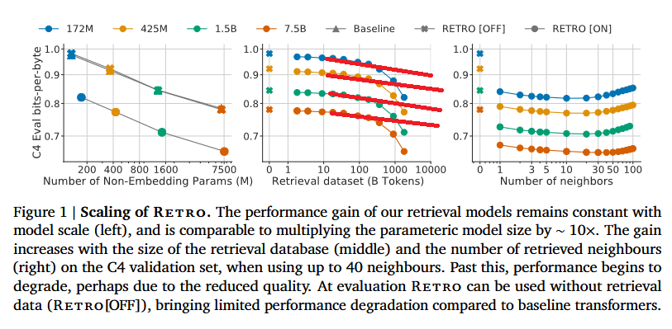
Improving language models by retrieving from trillions of tokens
Borgeaud et al. (2021) Improving language models by retrieving from trillions of tokens (https://arxiv.org/pdf/2112.04426)

Slide 27
A Neural Corpus Indexer for Document Retrieval
All supporting documents are semantically embedded.
Perform hierarchical k-means clustering on these embeddings.
Depending on a document's position in the k-means clustering hierarchy, generate a document id that encapsulates semantic information about the document's location in the k-means tree. E.g. cluster 3, subcluster 1, sub-sub-cluster 5 becomes 315
Train a LLM to regurgitate the doc_id given a question
Wang et al. (2022b) A Neural Corpus Indexer for Document Retrieval (https://arxiv.org/abs/2206.02743)

Slide 28
Contents
In Context Learning (ICL)
Retrieval Augmented Generation (RAG)
Subset Selection in LLMs with RAG and ICL

Slide 29
Core Idea of Subset Selection
Question: What does Jack have?
Information Retrieval
Model Knowledge
Context: Jack has an Apple
Question: What does Jack have?
Answer: Apple
Data Incorporation
Longlist
Jack has an Apple
Jill has a Ball
Bob has a Banana
Jack likes Bob
Shortlist
Jack has an Apple
Jack likes Bob
Subset-selection

Slide 30
Core Idea of Subset Selection
Question: What does Jack have?
Information Retrieval
Model Knowledge
Context: Jack has an Apple
Question: What does Jack have?
Answer: Apple
Data Incorporation
Longlist
Jack has an Apple
Jill has a Ball
Bob has a Banana
Jack likes Bob
Shortlist
Jack has an Apple
Jack likes Bob
Subset-selection

Slide 31
Core Idea of Subset Selection
Question: What does Jack have?
Information Retrieval
Longlist
Question: What does Jack have? Answer: Apple
Question: Which fruit does Jack like? Answer: Apple
Question: Who does Jack like? Answer: Bob
Model Knowledge
Question: What does Jack have? Answer: Apple
Question: What does Jack have?
Answer: Apple
Data Incorporation
Shortlist
Question: What does Jack have? Answer: Apple
Question: Who does Jack like? Answer: Bob
Subset-selection

Slide 32
What makes a document good?

Slide 33

Perplexity of the generative model
The simplest approach is random sample and test.
We pick the 1-shots which give the best accuracy over the dataset.
Min et al. (2021) MetaICL: Learning to Learn In Context (https://arxiv.org/pdf/2110.15943)

Slide 34
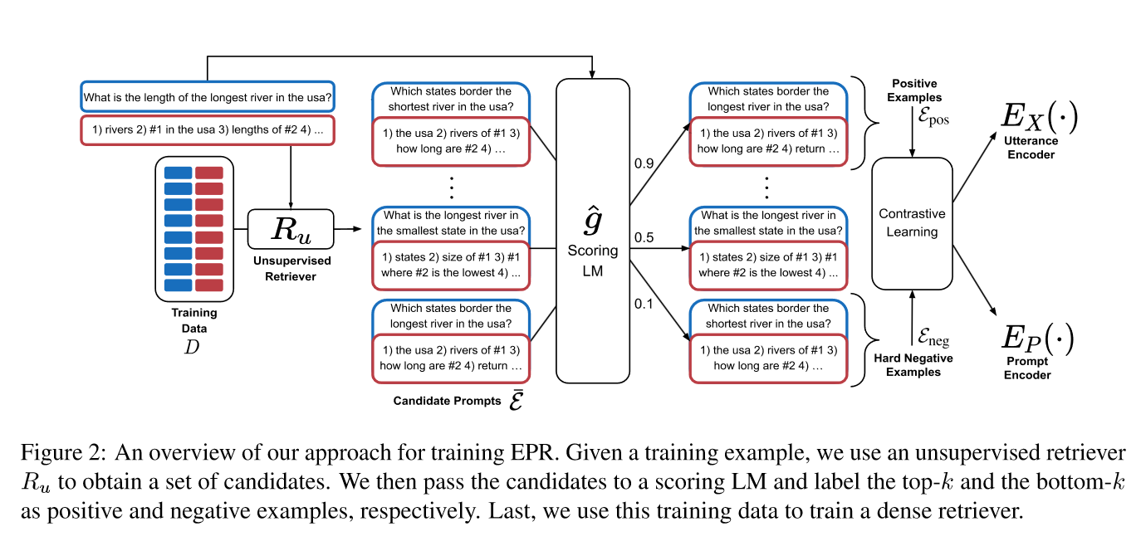
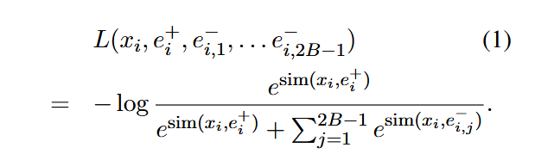
Learning To Retrieve Prompts for In-Context Learning
Rubin et al. (2021) Learning To Retrieve Prompts for In-Context Learning (https://arxiv.org/abs/2112.08633)

Slide 35
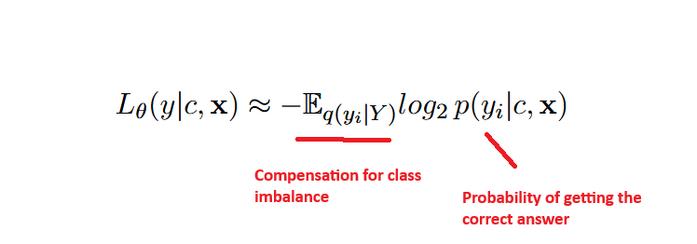
Self-Adaptive In-Context Learning: An Information Compression Perspective for In-Context Example Selection and Ordering
Wu et al. (2022) Self-Adaptive In-Context Learning: An Information Compression
Perspective for In-Context Example Selection and Ordering (https://arxiv.org/abs/2212.10375)

Slide 36
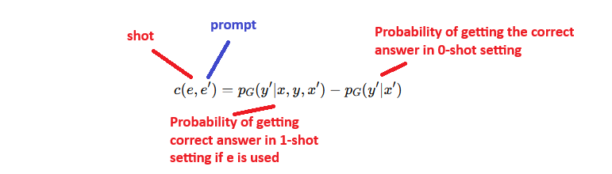
Finding Support Examples for In-Context Learning (1 / 2)
Li and Qiu (2023) Finding Support Examples for In-Context Learning (https://arxiv.org/pdf/2302.13539)

Slide 37
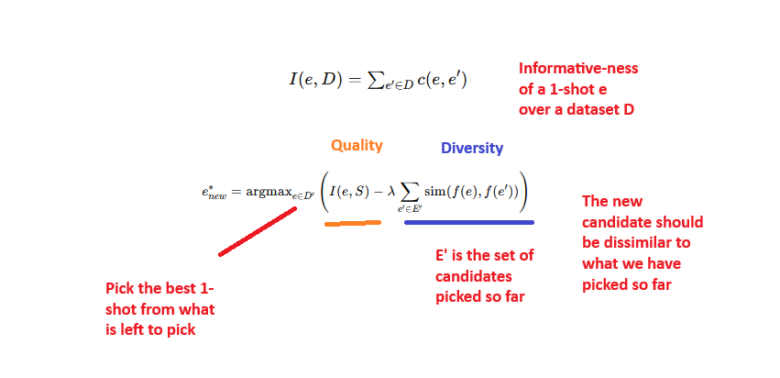
Finding Support Examples for In-Context Learning (2 / 2)
Li and Qiu (2023) Finding Support Examples for In-Context Learning (https://arxiv.org/pdf/2302.13539)

Slide 38
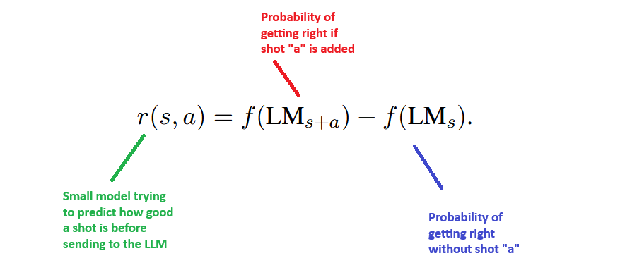
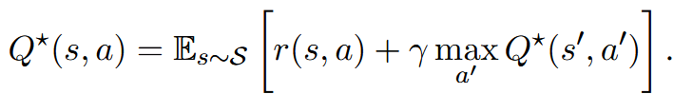
Active Example Selection for In-Context Learning
Randomly select few shots
Incrementally add them and evaluate the model.
Record the confidence of correct answer
Few shot + prompt is state, next shot to select is action and confidence is reward
Zhang et al. (2022) Active Example Selection for In-Context Learning (https://arxiv.org/abs/2211.04486)

Slide 39
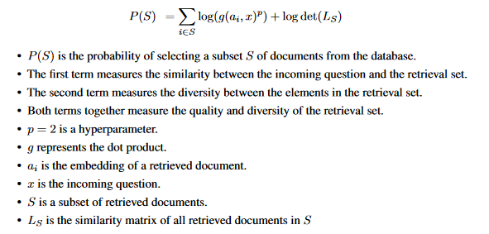
Compositional Exemplars for In-context Learning (1 / 2)
Ye et al. (2023) Compositional Exemplars for In-context Learning (https://arxiv.org/abs/2302.05698)

Slide 40

Compositional Exemplars for In-context Learning ( 2 / 2 )
For an incoming question, create an embedding. Find n most similar documents from the database N.
Take each document and question and check the likelihood of answering the question using a generating LLM.
Sort the documents by this score and divide into two parts. S+ and S-. S+ being highest scoring half and S- being lowest scoring half.
Use the contrastive loss to train the embedding model. It enforces both quality and diversity
L loss
P from last slide
S+ is 1-shot which gave high likelihood of correct answer
S- is 1-shot which gave low likelihood of correct answer
Ye et al. (2023) Compositional Exemplars for In-context Learning (https://arxiv.org/abs/2302.05698)

Slide 41
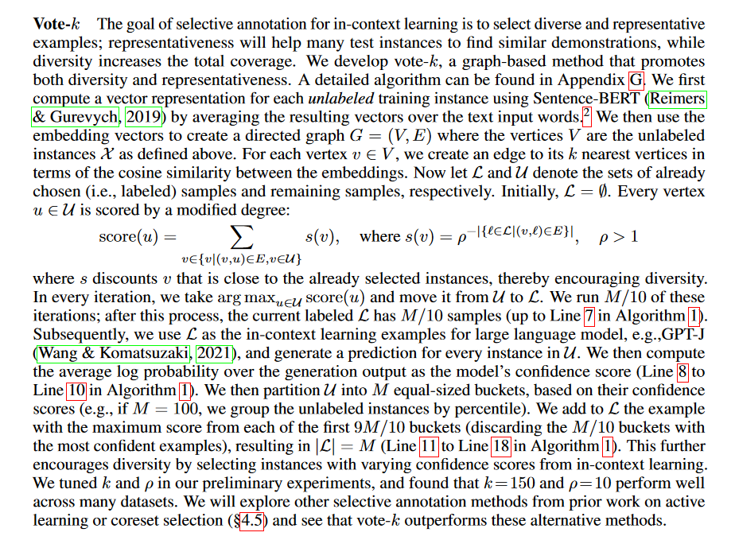
Selective Annotation Makes Language Models Better Few Shot Learners
Keep a counter of how many times
a document was helpful.
Each supporting document casts a vote, the more votes it casts, the less its strength of voting. Exponential decay.
Su et al. (2022) Selective Annotation Makes Language Models Better Few Shot Learners

Slide 42

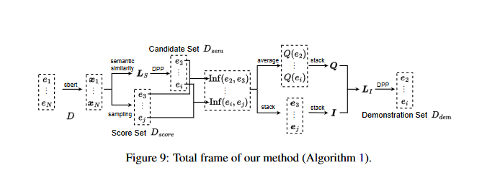


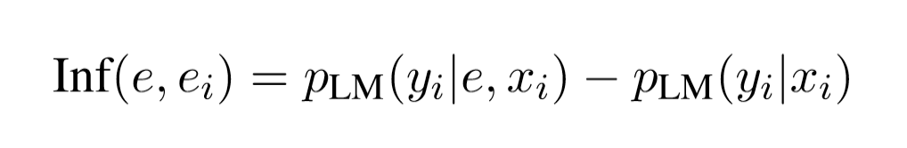
Representative Demonstration Selection for In-Context Learning with Two-Stage Determinantal Point Process
Yang et al. (2023) Representative Demonstration Selection for In-Context
Learning with Two-Stage Determinantal Point Process (https://aclanthology.org/2023.emnlp-main.331/)

Slide 43
IDEAL: Influence-Driven Selective Annotations Empower In-Context Learners in Large Language Models
Compute all to all similarity matrix
Start with a seed set
For each item in seed set pick the top K most similar items
Add these back into the seed set with probability inversely proportional to their similarity with the seed set (uniform random)
Continue until desired size
Zhang et al. (2023) IDEAL: Influence-Driven Selective Annotations Empower In-Context Learners in Large Language Models (https://arxiv.org/abs/2310.10873)

Slide 44
Selection Via Proxy: Efficient Data Selection For Deep Learning
Least Confidence: Pick the hardest examples
Train a proxy model (smaller, faster) on the whole dataset
Use this proxy to rank/score all samples based on specific criteria:
Forgetting events (how many times they flip from correct→incorrect during training)
Uncertainty/entropy measures
Select a subset of samples based on these scores (often the most "informative" samples)
Coleman et al. (2019) Selection Via Proxy: Efficient Data Selection For Deep Learning (https://arxiv.org/abs/1906.11829)

Slide 45
References (1 / 4)
Brown et al. (2020) Language Models are Few-Shot Learners
Wei et al. (2022b) Chain of Thought Prompting Elicits Reasoning in Large Language Models
Wang et al. (2022a) Self-Consistency Improves Chain of Thought Reasoning in Language Models
Min et al. (2022) Rethinking the Role of Demonstrations: What Makes In-Context Learning Work
Wei et al. (2022a) Emergent Abilities of Large Language Models

Slide 46
References (2 / 4)
Lewis et al. (2020) Retrieval-Augmented Generation for Knowledge-Intensive NLP Tasks
Sachan et al. (2022) Questions Are All You Need to Train a Dense Passage Retriever
Lindgren et al. (2021) Efficient Training of Retrieval Models Using Negative Cache
Borgeaud et al. (2021) Improving language models by retrieving from trillions of tokens
Wang et al. (2022b) A Neural Corpus Indexer for Document Retrieval

Slide 47
References (3 / 4)
Min et al. (2021) MetaICL: Learning to Learn In Context
Coleman et al. (2019) Selection Via Proxy: Efficient Data Selection For Deep Learning
Li and Qiu (2023) Finding Support Examples for In-Context Learning
Wu et al. (2022) Self-Adaptive In-Context Learning: An Information Compression Perspective for In-Context Example Selection and Ordering
Zhang et al. (2022) Active Example Selection for In-Context Learning

Slide 48
References (4 / 4)
Ye et al. (2023) Compositional Exemplars for In-context Learning
Yang et al. (2023) Representative Demonstration Selection for In-Context Learning with Two-Stage Determinantal Point Process
Rubin et al. (2021) Learning To Retrieve Prompts for In-Context Learning
Zhang et al. (2023) IDEAL: Influence-Driven Selective Annotations Empower In-Context Learners in Large Language Models
Su et al. (2022) Selective Annotation Makes Language Models Better FewShot Learners

